Slide 1
Redistricting MD-19 Challenges and Opportunities
PCC John Kirry, Chair
Strategic Planning Committee, August, 2021

Slide 2
The Strategic Planning Committee
ID Allan Hunt
CC Al Hedstrom
CCE John Moralek
VCCE Lyndon Harriman
PCC John Kirry
PCC JD Nellor
PCC Gary Reidel
ED Peter Anderson
PDG Shelley Costello
PDG Cecil Fung
PDG Steve Noble
PDG Brien Patton
PDG Tom Smarsh
PDG Chuck Waid
PDG Glen Barry
PZC Sharon Hansen

Slide 3
The Crisis We Face
Membership Continues to Plummet
1997, just 25 years ago: nearly 20,000 members
Steady and Dramatic Decline Since
Average Five Year Loss : -400 per year
2020-2021 Loss: -808 Largest Loss in MD History
If Membership Losses continue apace, the Multiple District could become extinct in 10 years or so.

Slide 4
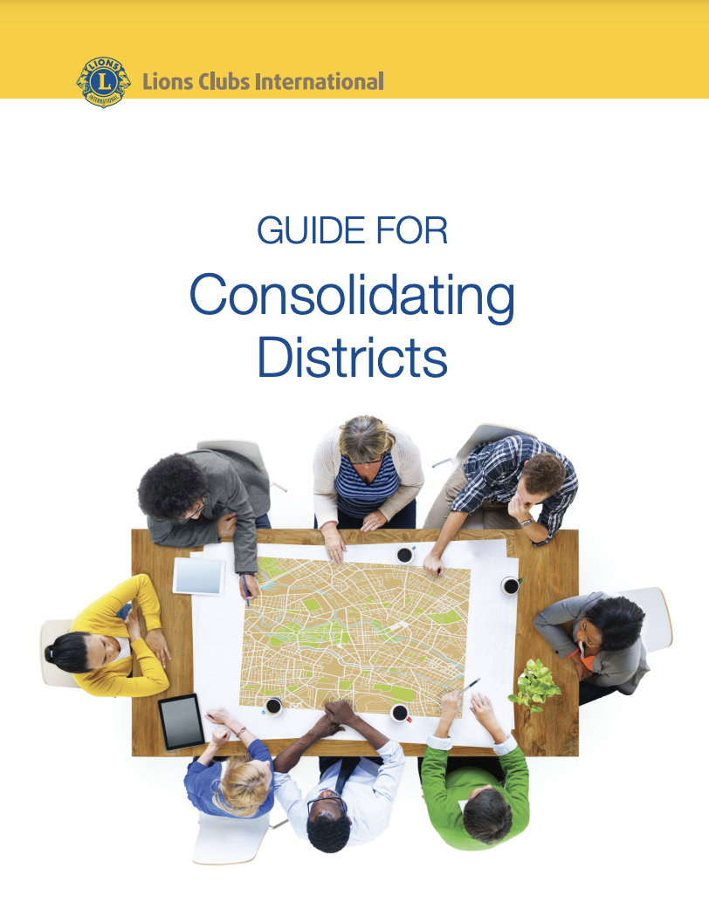
Guidance from LCI
Guide for Consolidating Districts
“Why Consolidate Small Districts?”

Slide 5
Guide for Consolidating Districts
LCI Statement 1
“Your District needs to run at a peak performance level to best support healthy clubs. In order to maximize the efforts of district leadership, it may become necessary to restructure to operate in a more effective and efficient manner. The redistricting process is designed to accomplish that task.”

Slide 6
Guide for Consolidating Districts
LCI Statement 2
“While the ideal size for a district has been debated, there is little doubt that a district should be large enough to have a sufficient pool of trained, qualified district leaders, a well-attended and meaningful district convention and ample resources to support club development.”

Slide 7
Guide for Consolidating Districts
LCI Statement 3
“While membership growth should always be a part of the plan, redistricting can infuse the district with a mix of new leaders who can look at district activities in a new way, combine resources to more effectively meet the needs of the clubs. Redistricting, when done well, can strengthen the district and stimulate membership growth, enhancing the districts’ ability to provide needed humanitarian service.”

Slide 8
The Redistricting Challenge
Redistricting is not a panacea.
Redistricting is not a substitute for an active and vital membership and retention program at every club.
Redistricting will not magically produce new leaders in our clubs.
A mix of new leaders in the new district can inspire new leadership models which can help clubs be more effective in accomplishing their service goals.

Slide 9
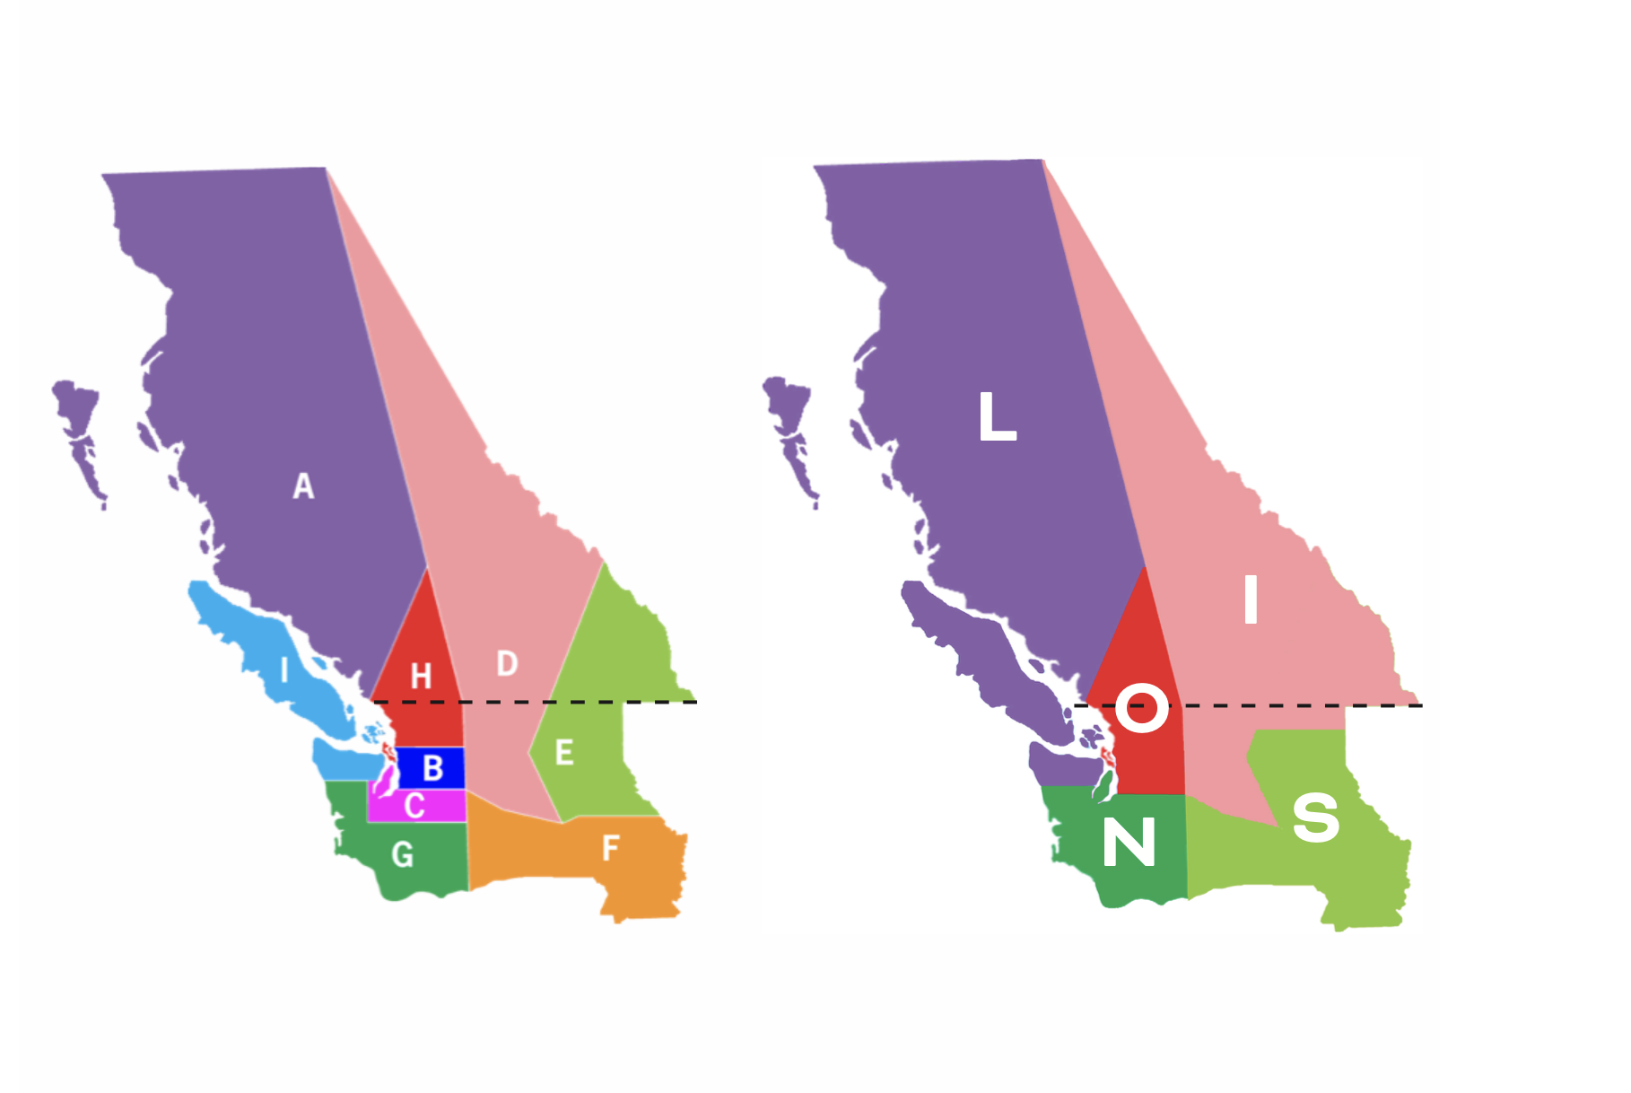
MD19 District Boundaries
Current Proposed

Slide 10
The Numbers
Five Districts from Nine
Merged / Realigned
Merged Districts I and A: | 2271 members, 97 clubs
Merged Districts B and H: | 1959 members, 76 clubs
Merged Districts C and G: | 2345 members, 82 clubs
Realigned Districts D and E | 1678 members, 75 clubs
Realigned Districts E and F | 1572 members, 64 clubs

Slide 11
Critical Timelines
District, MD and LCI
LCI must approve at Board Meeting, October 2022
Multiple District members must approve at special convention,
May or June 2022
Districts May Hold Advisory Vote at Spring convention

Slide 12
Special Considerations
Due to increase in District sizes, Districts should implement
a “shared” DG visit concept with 1VDG, 2VDG
Increase use of Zoom with Clubs
DG Speak at Zone Meetings with Multiple Clubs

Slide 13
The Path Ahead
Five Districts from Nine
Redistricting would be effective July 1, 2023.
Merger Committees would be created in Each District
These committees would make plans to integrate finances, Leadership, Constitution and Bylaws, Global Action Teams, Cabinet, Service Projects. Websites, Newsletters and Social Media, Conventions Etc

Slide 14
Resilience in the Face of Change
CC John Moralek’s Theme for 2020-21
We are about to set off in a new direction,
one that will require the energy and enthusiasm
of us all.
Redistricting is a big job, but we have smart, innovative,
cooperative, generous and resilient Lions who are up to
the challenges and opportunities ahead!

Slide 15
Questions and Answers

